Slide 1
SFPD DOJ-CRI In Progress Review
March 7th, 2017
Chief of police William Scott

Slide 2
Chief of Police William Scott
Sworn in January 23rd, 2017 – since then:
Initiated a reorganization of the Department Command Staff
Met with Supervisors, Police Commissioners, Community Members and Department Officers & Staff
Directed PSPPB to conduct a re-assessment of current reform processes
Notes:
-President Breed, Supervisors, thank you for this opportunity to update you on our department’s progress
-As a reminder, here are some of the first steps I took since taking charge a little over a month ago…
I believe the DOJ report offers a roadmap for the department that not only has a few defined checkpoints, but provides for a continual, and ongoing process that will long outstrip the 18 month Collaborative Reform Initiative with the Department of Justice. Our process will utilize the DOJ report as a frame to look at department policies and practices, and evolve the department into a national leader.

Slide 3
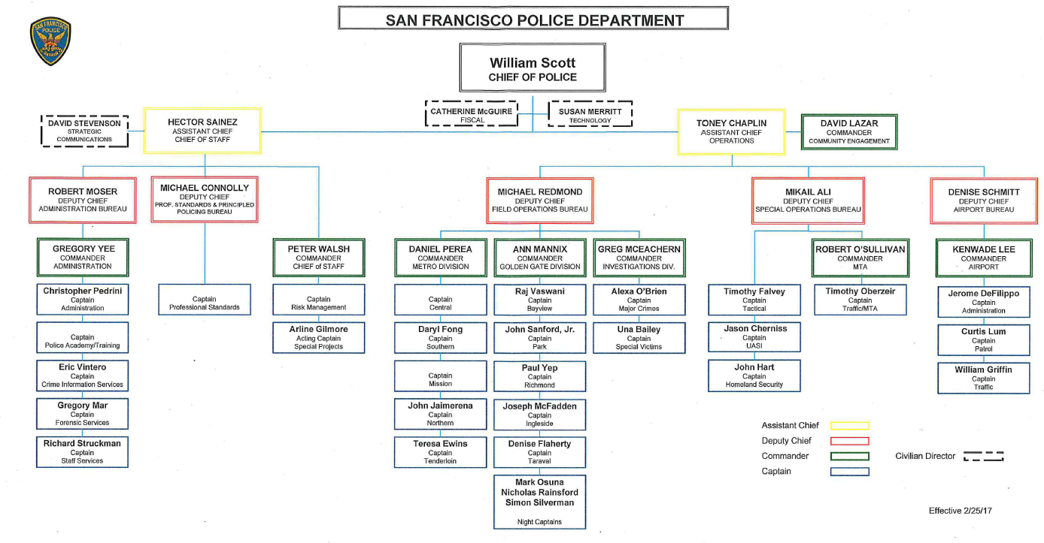
Increasing Leadership, Capacity & Accountability
Notes:
-Command Staff Changes. We have made changes to the command staff structure to increase accountability, capacity and continue our responsibility to maintain public safety.
This new structure is about organizational effectiveness and putting in place a team that will give the department the best opportunity to implement the reforms in a successful and sustainable way, while maintaining public safety.
We have added 2 Assistant Chiefs, and 3 Commanders, total costs of these changes is approximately 1.65m.

Slide 4
Background
DOJ Report released October 2016
First Joint Board and Police Commission Briefing, November 2016
Overview and policy discussion
Integrated matrix discussed (DOJ, CGJ, Blue Ribbon)
Measurable progress:
Use of Force DGO adoption & implementation
OIS Notification System
E Stops and database backend launched this past January
CIT GO adopted and CIT Field Tactics Training
Principled Policing Curriculum: Implicit Bias & Procedural Justice Training – 432 Officers and Staff (or 20% of the workforce) trained to date and integrated into ongoing yearly training
Notes:
To remind the board, we received our DOJ report in October of last year, and briefed a joint meeting of the Police Commission and Board of Supervisors in November on or way forward.
Since then, we’ve achieved some measurable progress, which I’ll highlight in a moment.
A note on Implicit Bias and Procedural Justice training: All officers and sergeants are receiving 8 hours of Principled Policing during the 2017-19 Advanced Officer/Continuing Professional Training cycle. The Principled Policing curriculum covers Procedural Justice and Implicit Bias Training.
The Principled Policing Curriculum is in addition to a 2 hour implicit bias course that was run from 2015 and 2016. 1,847 officers attended that course over the 2 years it was offered. That course has sunset and has been replaced by the Principled Policing Curriculum

Slide 5
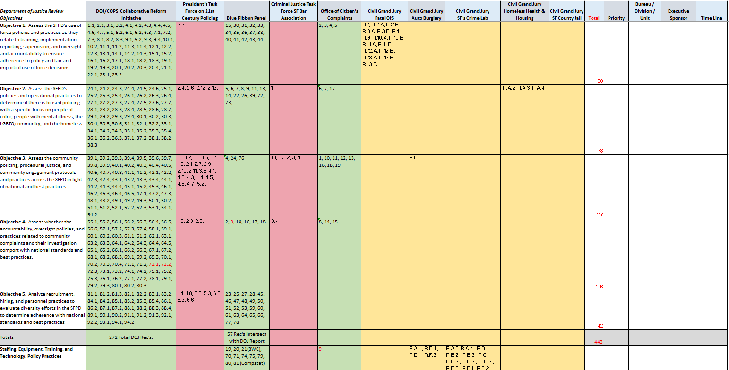
Reports Overview
DOJ
BRP
CGJ
479 total recommendations
Report | # of Recs
DOJ | 272
BRP | 81
21st C. Policing | 47
CJTF Bar Assn | 8
OCC Response | 19
Civil Grand Jury (x5) | 52
Total | 479
Notes:
-Reminder that we’re working 479 report recommendations. 272 from the DOJ, and others from Blue Ribbon, the 21st C. Policing report, the Bar Association and Multiple Civil Grand Jury Responses.
-The DOJ report provides an excellent framework from which to address the additional recommendations.
-As we complete DOJ recommendations we believe we address, in principle, the other report recommendations.
-DOJ provides a solid road map that we’ve embraced, that’ll help us address the remaining reports through the future
Example:
BRP # 8: The SFPD should update its current data collection policy to clearly define when data collection is required.
DOJ # 34.3: The SFPD should consider expanding the functionality of the E585 traffic stop incident report data collection system to include data collection for all pedestrian and non-motorized conveyances.

Slide 6
Addressing Potential Bias
Implicit Bias & Procedural Justice training continues
Not on My Watch program continues
Planning for growth of program to address all misconduct
Seeking additional academic advisors to assist with analysis of stops, citations and use of force data
Implemented ongoing auditing of department electronic communications w/ automated notification to Internal Affairs
Notes:
-Launched Implicit Bias / Procedural Justice Training. Now included in both Academy classes and ongoing refresher training for the department.
-Improving the Not on my Watch program by expanding it to include all misconduct
-Academic assistance on all database development and research
-Audits of department electronic communications are complete and now regularly executed. No purposeful violations found by IA. Ongoing for 4 months, based on technology implementation
Text messages audited from May 2016
Emails audited from November 2016
Vehicle Terminals audited from Dec 2016
Vendor limitations kept us from going back any further than May 2016

Slide 7
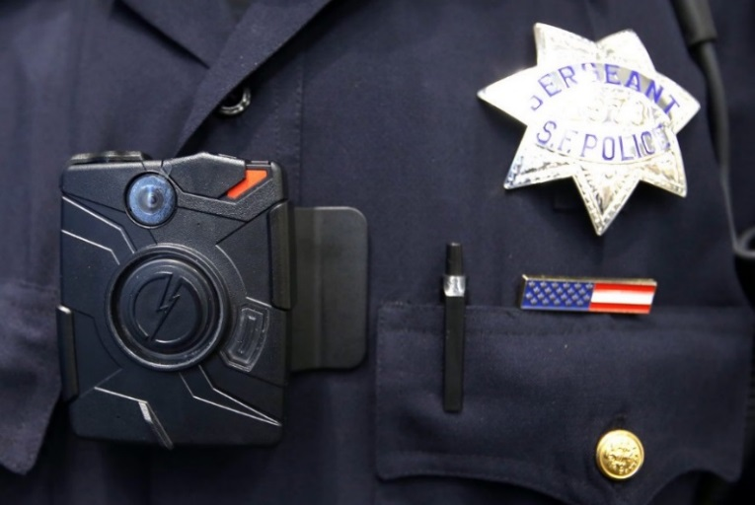
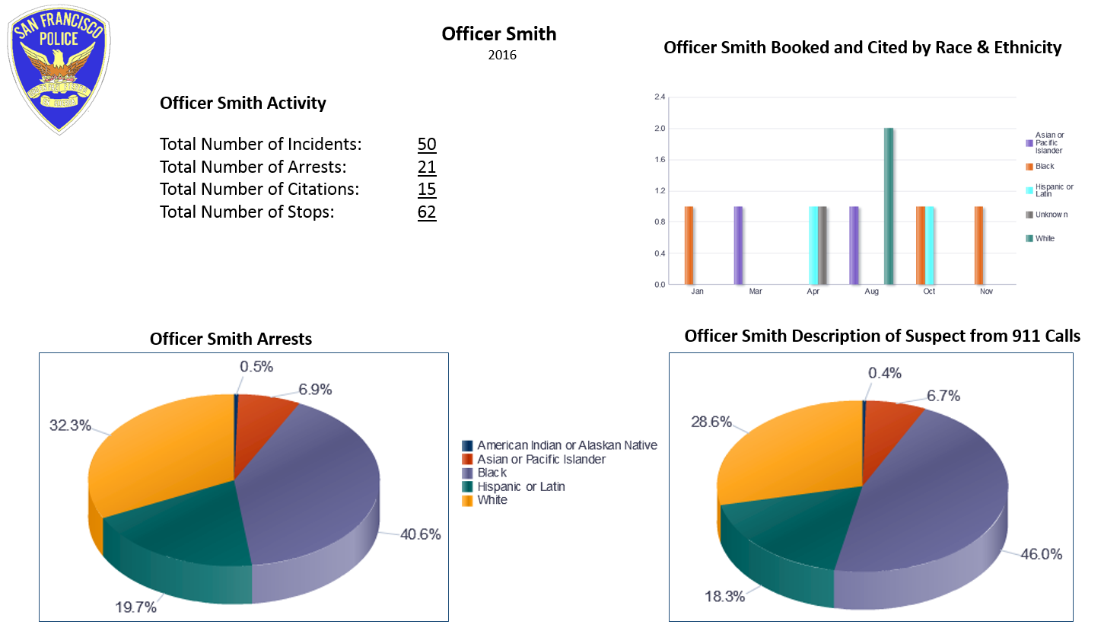
Accountability
Body Worn Cameras fully deployed
Planning stages of an Audit and Inspections Unit
EIS program partnering with Academic Institutions to improve data analysis
Continued emphasis through Department Leaders on our values based policy and commitment to fair and impartial policing
Developing Officer Performance Dashboard
Conceptual Officer Performance Dashboard
Notes:
-Fully deployed BWC coverage. Over 100k videos recorded thus far.
-Creation of an Audit unit with this budget cycle to sustain DOJ mandated changes into the performance culture of the department.
-Improving the EIS program with the help of Academia
-Developing an officer dashboard to assist supervisors in officer management & evaluations. This mirrors DOJ recommendations 27.4 and 27.5,
27.4 “To ensure first line supervisors understand the key role they play in addressing bias, supervisor training should include coaching, mentoring and direct engagement with problem officers”
27.6 “The SFPD should measure the efficacy of such training through careful data collection and analysis practices, ideally in partnership with an academic researcher”

Slide 8
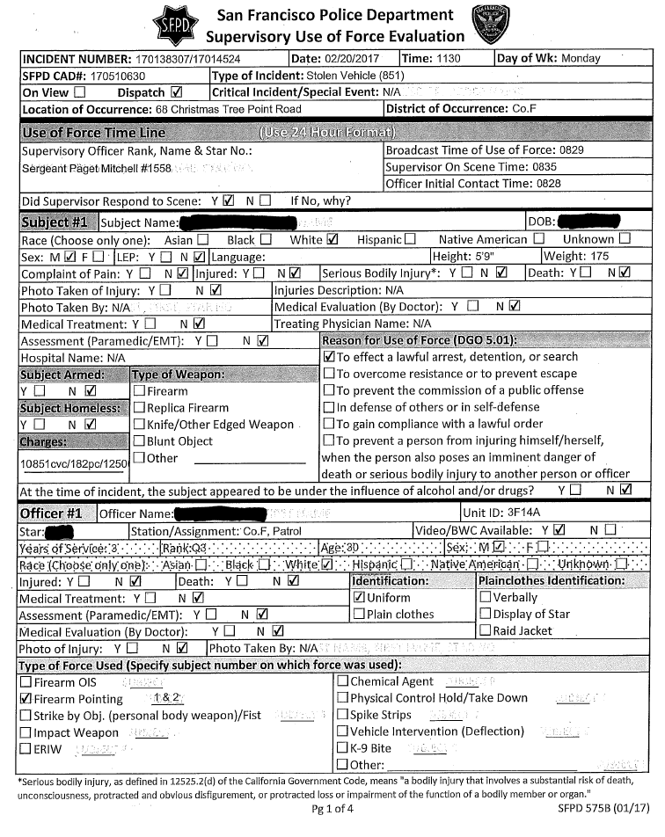
Use of Force
-Use of Force DGO adopted December 2016
-Immediately bans:
-Carotid restraint
-Shooting at moving vehicles
-Use of Force Training on DGO 5.01 ongoing
-Officers undergoing 20 hour foundational training
-Goal: Stations to be fully trained by end of Summer, 2017
- As of today, 160 officers have completed since training began in January
Revised Use of Force reporting & investigations form requirements in place
Mandated under Department Bulletin 17-006, issued January 2017
Mandates immediate supervisor evaluation of reportable Uses of Force
Pointing of a firearm continues as a reportable Use of Force
Increased data capture will assist in future analysis
System on track to be digitized in line with other applications
Notes:
-DGO 5.01 passed in December – training of the department to be complete by this summer
-Revised UoF procedures capturing uniform data across encounters – database is now being populated and provides the basis for our 96A quarterly report.
-Data to be integrated into COMPSTAT meetings.
Uses of Force Oct. Nov. Dec. Total Percentage
Pointing of Firearms 293 190 218 701 73.70
Number may include multiple officers and multiple subjects in a single incident
Addressed by both Range Requalification, CIT training (for team engagement planning) and the Academy

Slide 9
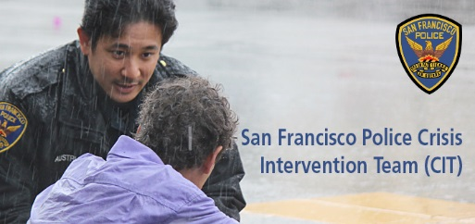
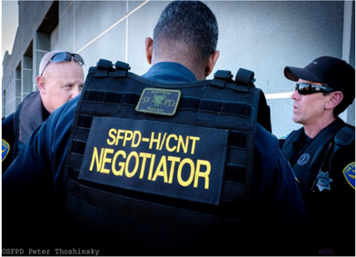
Crisis Intervention Training (CIT) - Field Tactics
New 2 day Field Training developed in addition to the 40 hour (1 week) CIT certification course
-Scenario Based Team Training, provides officers practical application of CIT policy and concepts
(De-escalation, communication, time & distance)
-Department pursuing State level certification for CIT FT
-Goal: All stations trained by end of Summer, 2017 in conjunction with UoF Foundational training
-CIT Basic 40 hour Course ongoing
-Approved CIT General Order, effective December 2016
Notes:
-DGO 5.01 passed in December – training of the department to be complete by this summer
-Adding Crisis Intervention Team – Field Tactics to give practical CIT training , again, to the whole force, by this summer
-CIT general order also passed in December to help guide our Crisis Intervention Team efforts
-Department continues to work with the Mental Health working group

Slide 10
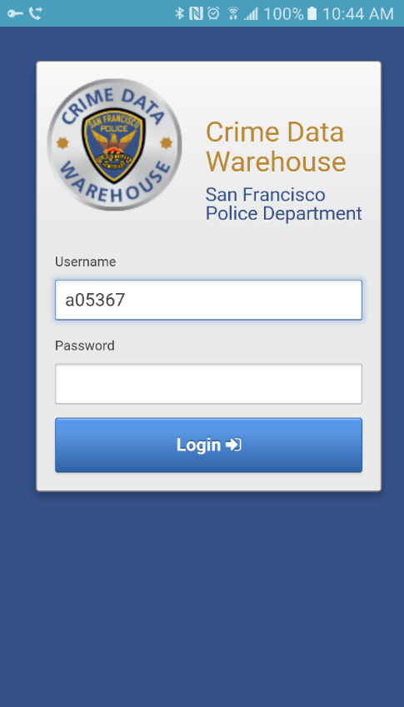
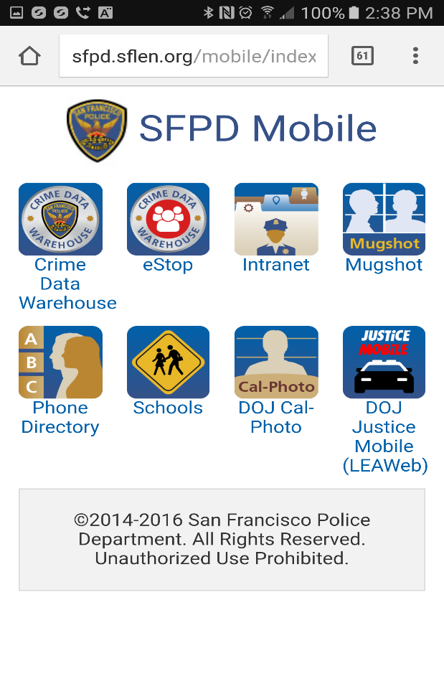
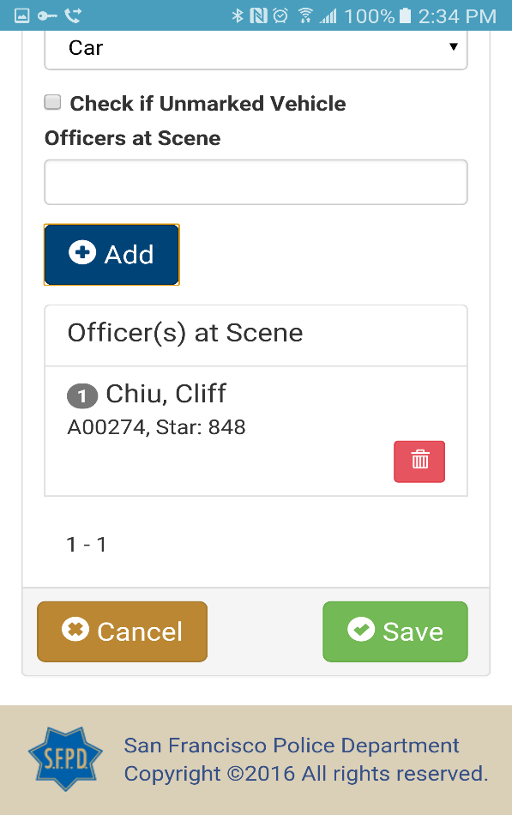
Growing Technological Capabilities
Use of Force database has been developed. Expanding capabilities to automate Use of Force reporting
E-Stops has been deployed and the database is active. Working towards automated report generation, analysis and publishing.
CA DOJ is looking at the Department’s collection practices as a State wide best practice.
Deployed an automated OIS notification system for automatic notification of DEM, DPA, the District Attorney’s Office and key Police Department members
Developing robust CIT data capture and analysis capability
Notes:
New technology from our department’s IT shop includes:
-Estops data collection for all vehicle and pedestrian interactions (started when?)
-Beta testing E Citations app for all moving violation data
-Developing Use of Force application for UoF form automation
-Developing CIT application for CIT form automation
Estops data will be integrated into the 96A report per legislative mandate this summer.
By creating an digital point of entry (from a previous manual system), future data sets will be automated, easier to analyze and will speed (and eventually automate) reporting requirements. (AB953/Admin 96.A)
OIS notification system has been upgraded from an old manual phone tree style system to an automatic phone/email/text system with built in rollover functionality and built in auditable reports.

Slide 11
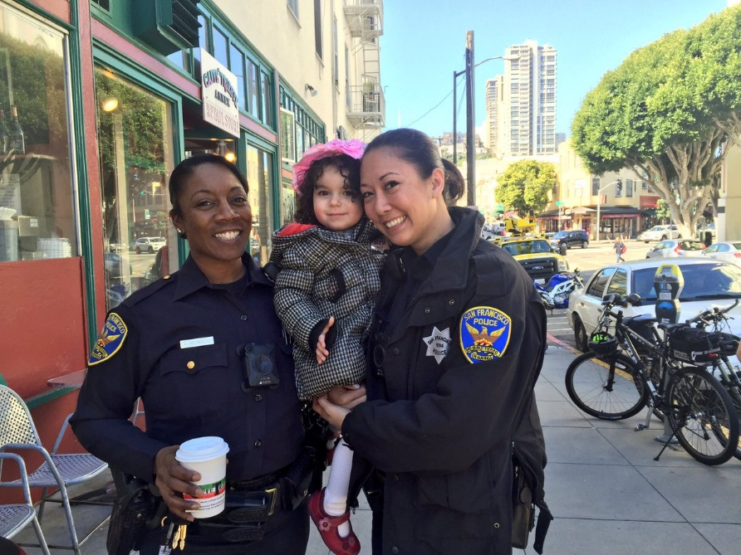
Community Engagement Division
Communications
External
Established Community Engagement Division
Chief’s Advisory Forums
Faith based Groups
Interagency Partners
District Level Events (CPABs, Newsletters, Coffee w/a Cop, Backpack Giveaways)
Internal
Role Call Training
Leadership Circulation
Employee Groups
Notes:
To show how much I emphasize the role of the community in our department, I have created the Community Engagement Division, which will provide a focused community engagement strategy.
External Comms
-Meeting with our community (coffee w/ a cop, monthly Captain’s meetings, etc)
-Successful social media outreach campaigns
-Need to update our website to make it more useable.
Internal Comms
- Listed above
- Also thinking about a possible podcast, monthly video message or newsletter
9 Advisory Forums to be re-invigorated and/or organized for the first time:
-African American/Black
-Hispanic/Latino
-Asian/Pacific Islander
-LGBT
-Woman’s
-Youth
-Interfaith
-Muslim/Islamic
-Jewish

Slide 12
Recruiting
-Nationwide recruiting campaigns ongoing
-Engaging Community Colleges between now and May
-SFPD Recruiting will visit Atlanta (among other locations) later this month (in addition to SF Bay area recruiting campaign.)
-Atlanta visit will be first written, physical and interview testing cycle for SFPD candidates outside of San Francisco.
-High interest from college students attending Historically Black Colleges & Universities
-Established monthly women’s workshop to assist in Entrance Exam and Academy physical requirements
Notes:
Atlanta visit will be first written, physical and interview outside of San Francisco.
The Women’s Workshop provides for candidate success by addressing a need for physical conditioning. Seeks to increase female success rate at PAT and Academy, which tend to be upper body strength heavy.
In 2016, the unit held 243 different recruiting events across the country
These events were focused on the following, depending on the type of event being held:
Veterans/Military – 13% Women – 5% African Americans – 9% Hispanic/Latinos – 4%
Asian/Filipino/Pacific Islanders – 6% College Campuses/Career Centers/Campus Veterans Groups – 27%
General Recruitment event (no demographic targeted) 30%
This semester we’re engaged with City College to run a Course (1 unit) that preps individuals for Application and Preparation for the Academy. 2 hours per week.
Demographics of our current Academy Class are:
White AA/Black Hispanic Asian Filipino Male Female Total
14 9 13 7 2 35 10 45
31% 20% 29% 16% 4% 78% 22%

Slide 13
Reform Status
The 272 recommendations are in the following status’.
In progress: Actively being worked by Project Managers (PMs)
Awaiting Document Packet: Reported complete by PM, pending paperwork submission to Professional Standards
In approval process: Pending review by Professional Standards and Command Staff
SFPD Complete/DOJ Review: Completed & submitted to DOJ
Notes:
As of today, we have 4 recommendations Complete and submitted to the DOJ, with another 42 recommendations being reviewed for approval, and 233 recommendations actively being worked by the department. 4 of the 58 Immediate priority recommendations (7%) are complete, another 19 (33%) are pending my review, and the remaining 35 (60%) are in progress with their Executive Sponsor and Project Managers.
We believe we are on track to complete our recommendations “on time”, however, we are at the start of not just an 18 month process, but a continual, and ongoing process that will long outstrip the 18 months in the DOJ report.
A summary document is available online today and provides a more in detail breakdown by Objective area.
I’d also like to note that we have implemented significantly more than just the 4 “SFPD Complete” recommendations noted on this slide. Several recommendations have been implemented and are pending backup documents, while others may be complete but require a round of auditing.
For example – the OIS notification system I mentioned earlier is not yet “SFPD complete” – I have determined the recommendation needed language that codified how it can be audited. When that language is included, that recommendation will likely move into the SFPD complete section.
Status of Recommendations:
• Awaiting Document Packet: 4.5, 43.1, 43.2, 66.2, 66.3, 76.1, 76.2
• In Approval Process: 8.1, 14.1, 14.2, 14.3, 15.2, 23.1, 24.4, 24.5, 26.2, 26.3, 28.6, 28.7, 29.4, 34.2, 34.3, 35.4, 39.5, 44.3. 50.2, 55.1, 64.2, 66.1, 68.2, 73.1, 75.3, 83.1, 83.2, 88.4
• SFPD Complete/ DOJ Review: 3.1, 7.3, 13.1, 17.1
• In Progress: Remaining 233 recommendations

Slide 14
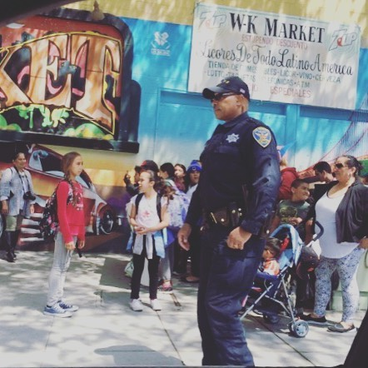
Next Steps
Ongoing Implementation of DOJ Findings & Recommendations
Department reporting continues:
-Monthly to the Police Commission
-Quarterly to the Board of Supervisors
-Continually with the Department of Justice
-Continually with the Public via:
Website, Social Media, Community Engagement Division, News Releases, Advisory Groups

Slide 15
Questions?

